Slide 1
Week 3
OFDM Transmitter and Receiver Block diagram, Importance of Cyclic Prefix, Case study - Modern antennas

Slide 2
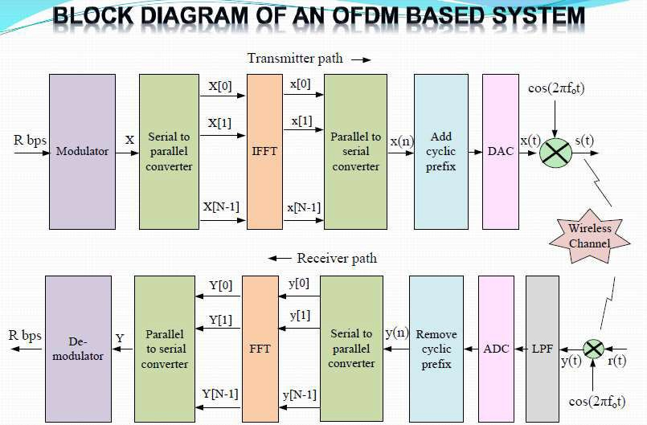

Slide 3

OPERATION OF OFDM
Typically PSK or QAM modulations schemes are used
IFFT performs the transformation efficiently and ensures orthogonality of the sub carriers
Output of IFFT is
Number of computations are significantly reduced by IFFT
IFFT needs that the number of sub-carriers be an integer to the power
of 2
Unused sub-carriers are set to zero
Complexity of OFDM system is largely determined by IFFT points
More IFFT points demands more power, but enhances resolution

Slide 4
CYCLIC PREFIX
Guard time between adjacent symbols is inserted to eliminate ISI
No ISI will occurs, if guard time is larger than delay spread
Guard time is a pure system overhead, contains no information
CP is inserted in order to preserve orthogonality
CP provides multipath immunity & synchronization tolerance
CP increases required transmission bandwidth, hence lowers spectral efficiency
Transmit power associated with CP is a waste

Slide 5
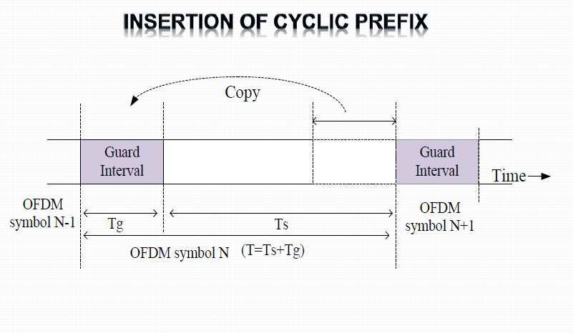

Slide 6
OFDM DISADVANTAGES
HIGH PAPR (Peak to Avg Power ratio)
A number of independently modulated sub-carriers result in HIGH PAPR
Non-linear power amplifier, efficient, but cannot be used
Causing performance degradation due to high distortion & out of band radiations
High PAPR also increases complexity of ADC & DAC
FREQUENCY OFFSET
Sub-carriers are very close and overlapping
Even a small frequency offset will result in ISI
Causes of frequency offset:
Frequency mismatch in local oscillators of transmitter & receiver Doppler shift
Phase noise caused in the channel

Slide 7
TIMING OFFSET
OFDM is slightly more tolerant to time offset, compared to frequency
offset
Causes lack of precision in symbol boundaries, resulting in ISI
ISI occur only when time offset differs from CP duration
Causes phase change & may also result in frequency offset
OFDM demands strict synchronization in frequency & time to preserve orthogonality

Slide 8
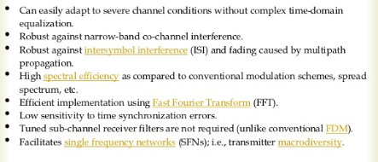

Review Questions
List out few characteristics of OFDM.

Slide 9
Case study - Modern antennas

